Slide 1





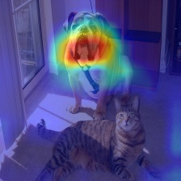
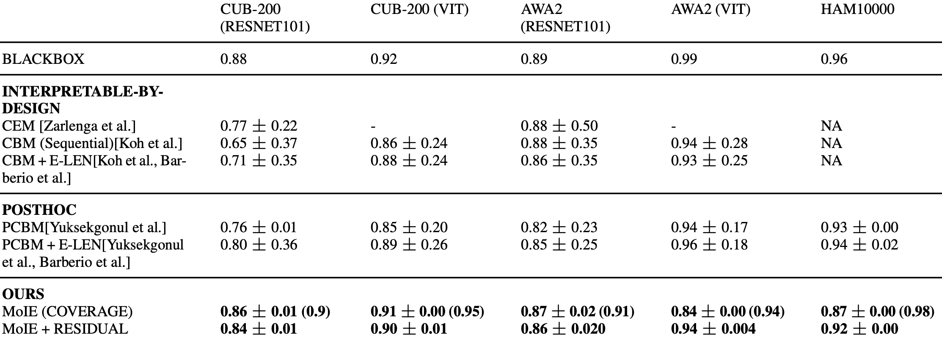




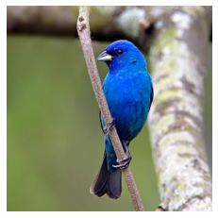
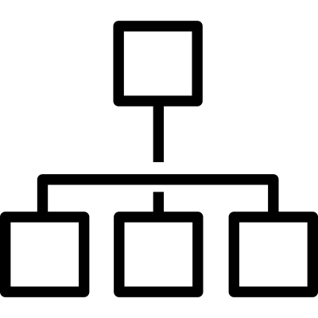

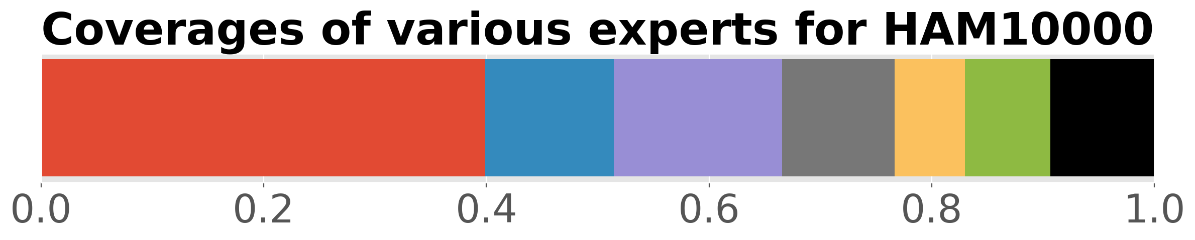


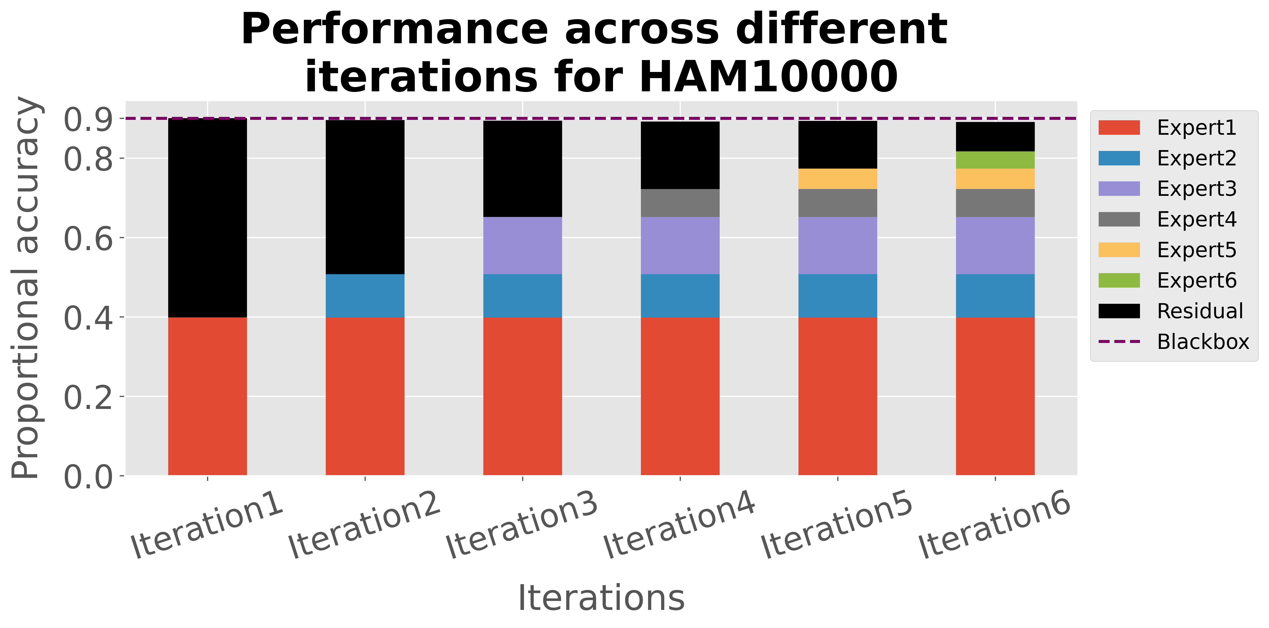
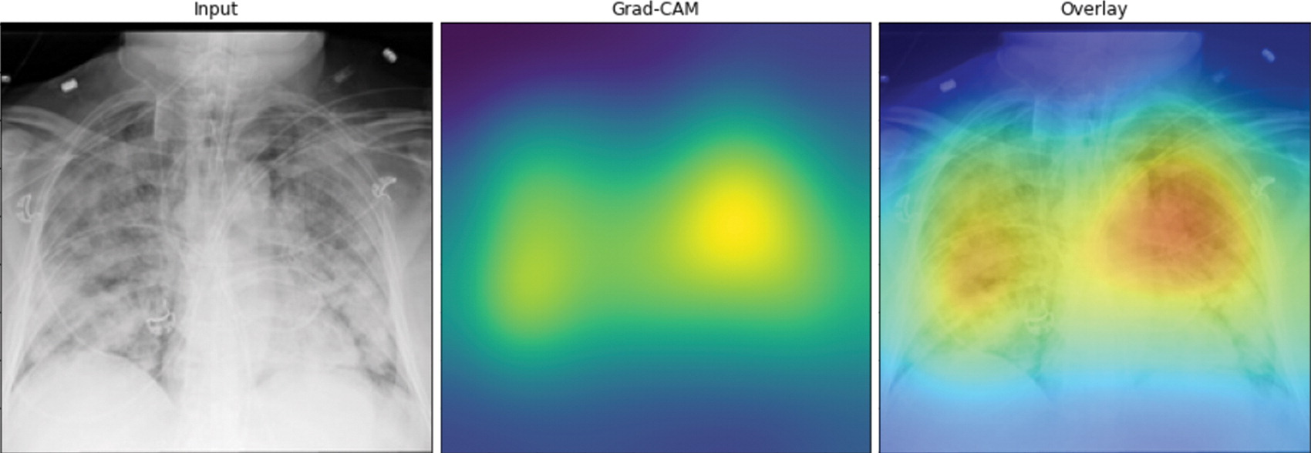
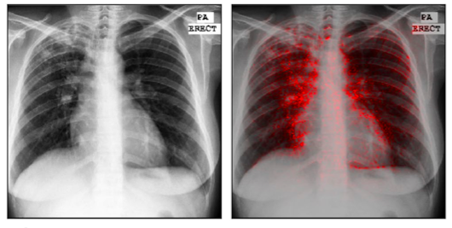
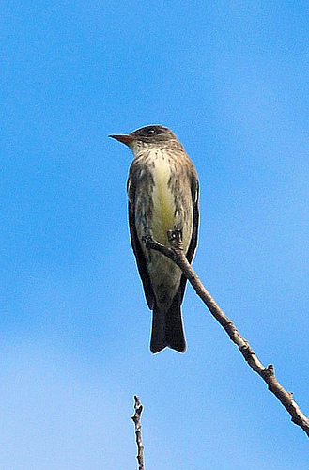
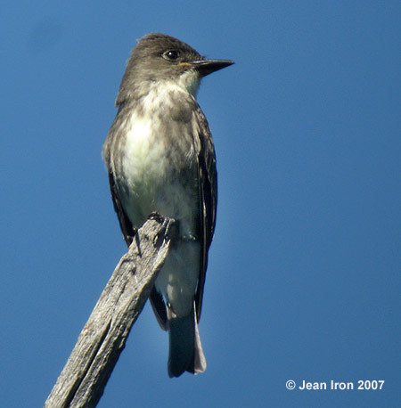
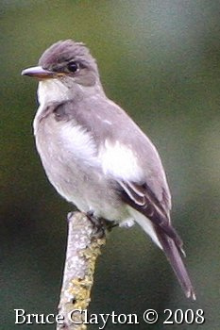
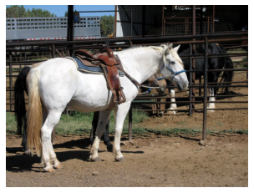
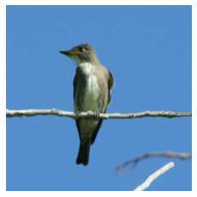
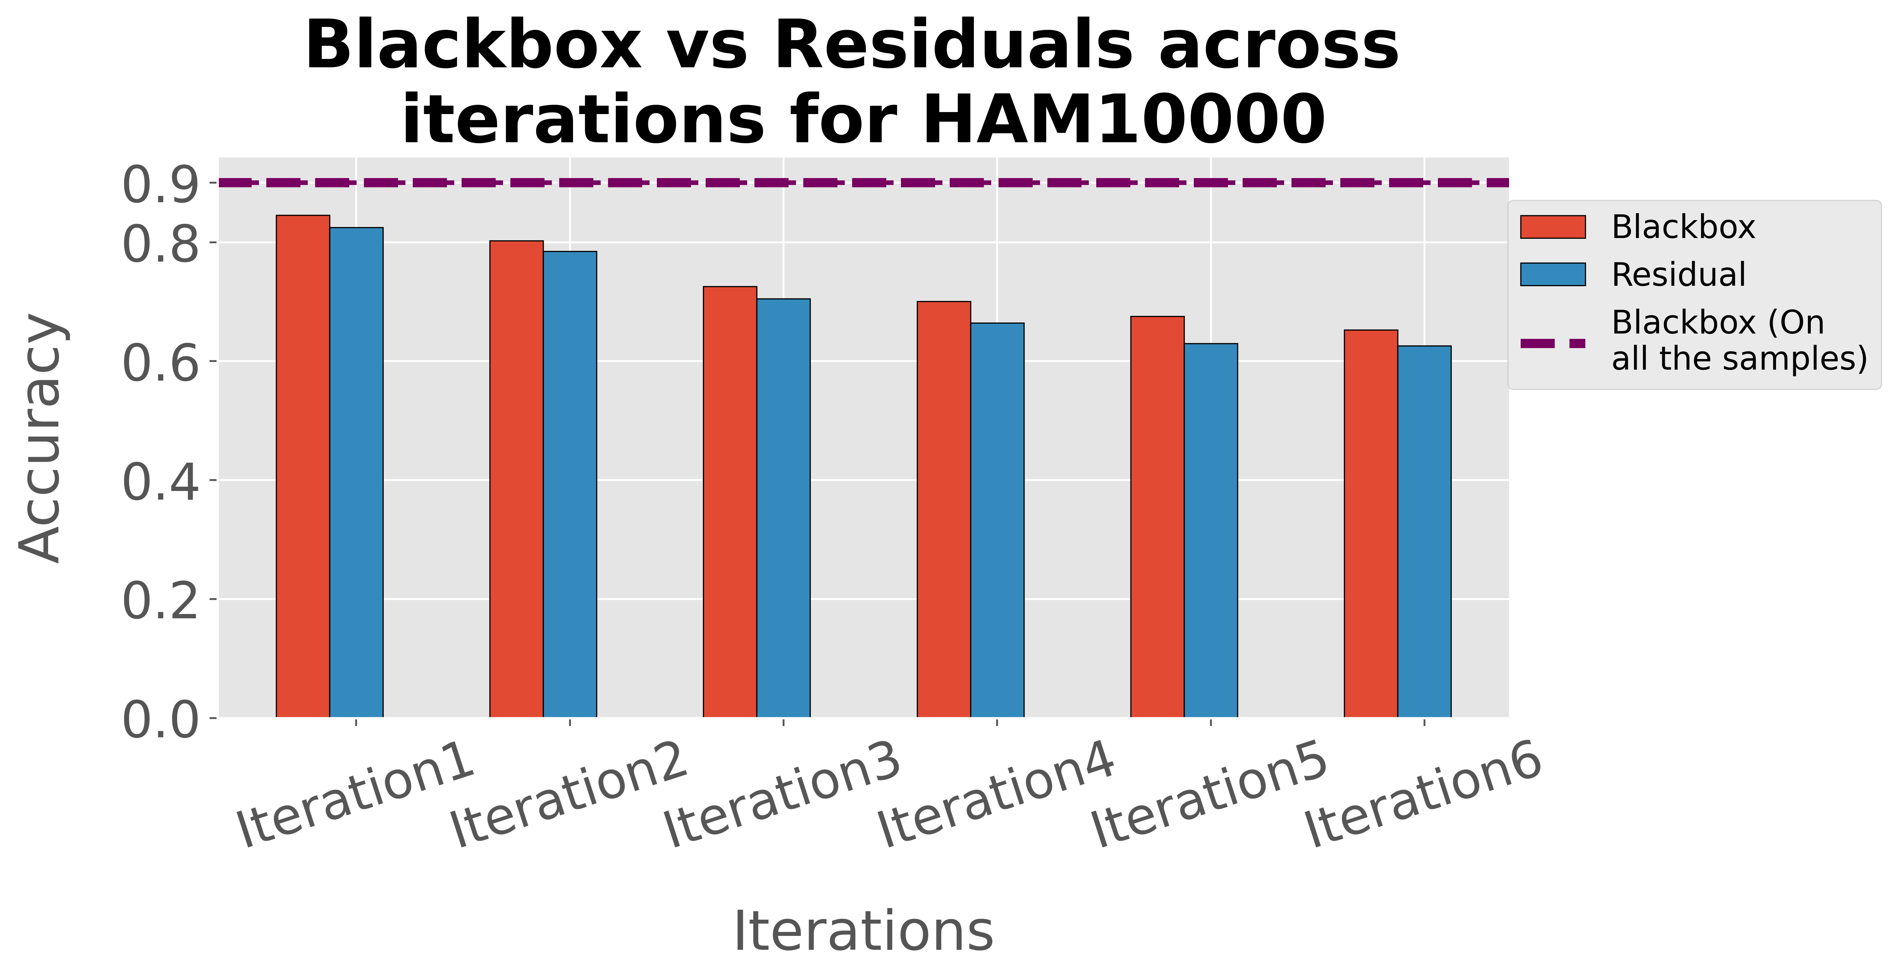
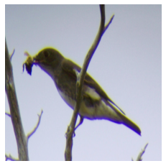
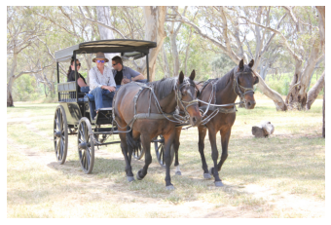
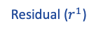
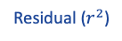
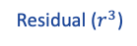
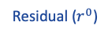
Dividing and Conquering a BlackBox to a Mixture of Interpretable Models:
Route, Interpret, Repeat
Shantanu Ghosh (BU), Ke Yu (Pitt), Forough Arabshahi (Meta), Kayhan Batmanghelich (BU)
project website
TLDR: Extracting a mixture of interpretable models from a BlackBox to provide instance specific concept-based explanations using First-order logic (FOL).
Deep learning model explanation is dichotomous
Route Interpret Repeat
Not compromising performance
Create
a
BlackBox
Explain post-hoc
Or
Residual ($r^{0}$)
Residual ($r^{1}$)
Residual ($r^{2}$)
Residual ($r^{3}$)
Interpretable by design models (e.g., CBM [Koh et al.])
Concepts
1. Bill shape hooked
2. Medium size
3. Bill shape cone
4. Bill color black
…..
Later experts cover harder samples
Feature
extractor
Bird species
Blackbox Model
Symbolic Model
Selector
Motivation
Poor
localization
Affinity
for the edges
Each g is E-LEN [Barberio et al.], constructing FOL
* SelectiveNet [Geifman et al.] optimization
Post-hoc explanations maintain performance of the Blackbox but suffer from a lack of fidelity. Thus, recourse to a model’s undesirable behavior is unclear [Rudin et al.].
For CBMs, single interpretable classifier explains all the samples of class, offering generic explanations.
Capturing heterogenous explanations
* Extracted from VIT-based BlackBox
Expert4
Expert6
Final residual (Unexplained)
Notation
Also in our paper,
+ we achieve higher concept completeness scores
+ we achieve higher accuracy during test time intervention
+ we eliminate shortcut learning problem
+ VIT-based experts compose less concepts than CNN-based ones
CBM + E-LEN
PCBM + E-LEN

